Slide 1
Car Rental Data Quality - Numeric
08-15-22

Slide 2
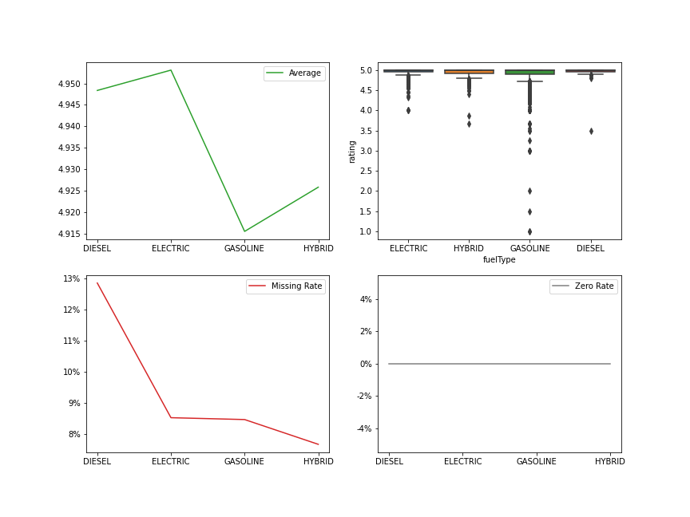
rating

Slide 3
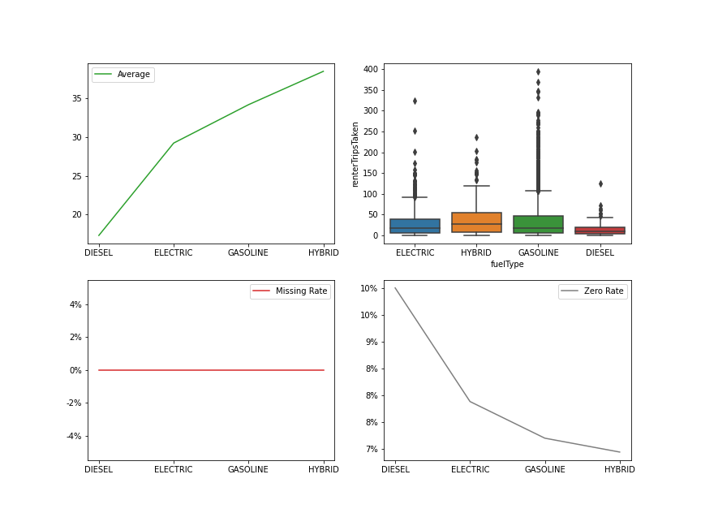
renterTripsTaken

Slide 4
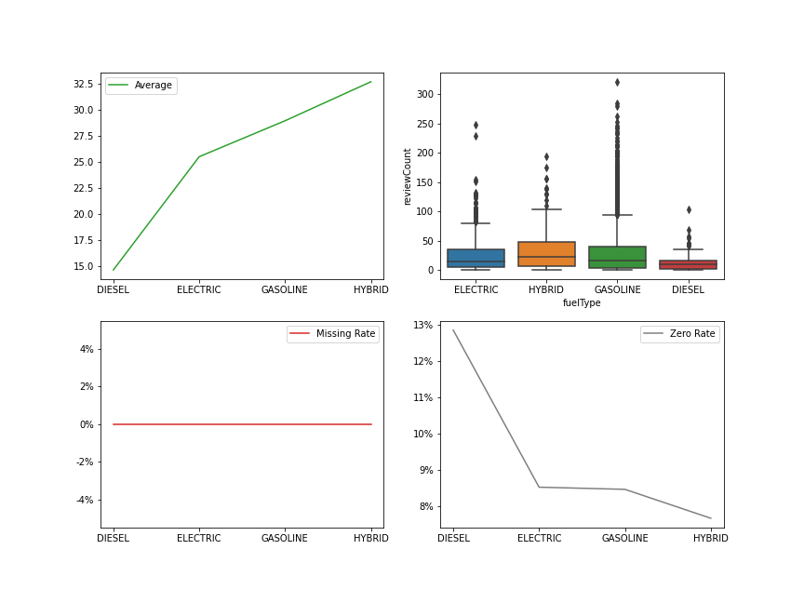
reviewCount

Slide 5
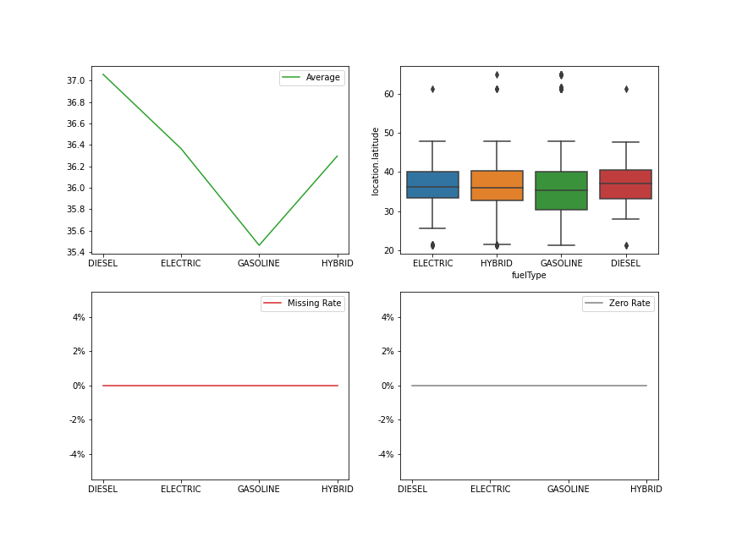
location.latitude

Slide 6
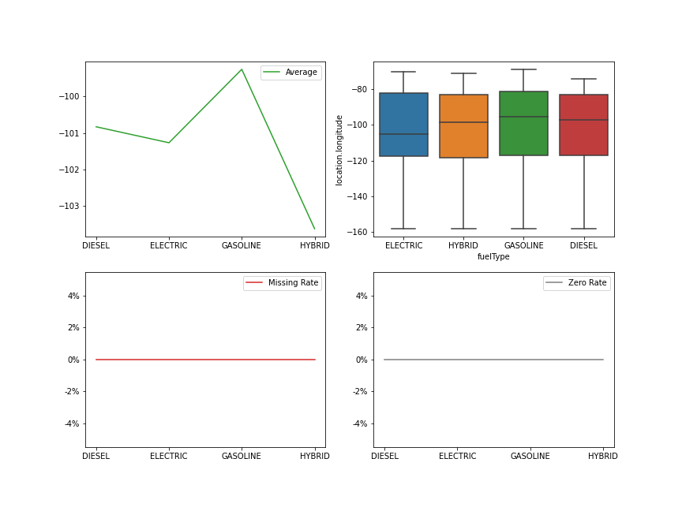
location.longitude

Slide 7
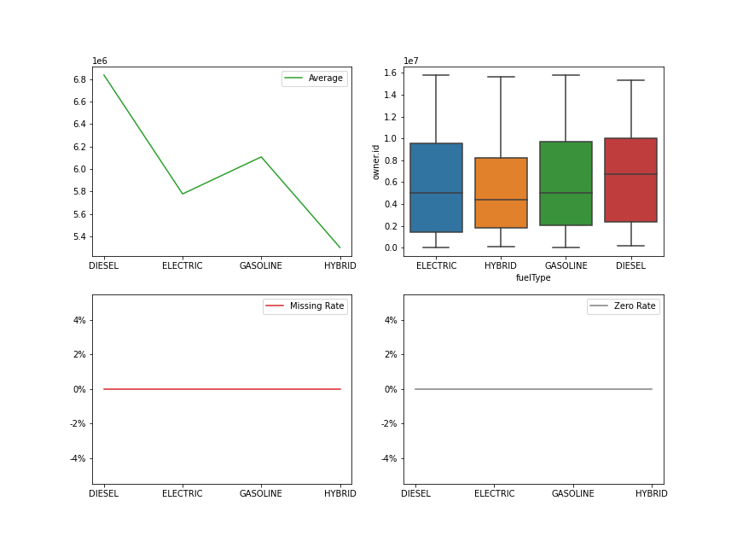
owner.id

Slide 8
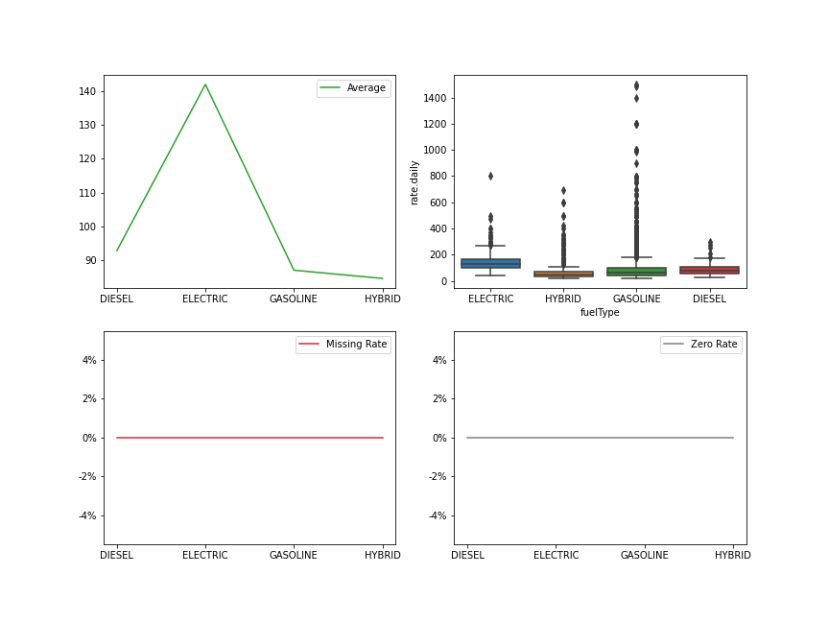
rate.daily

Slide 9
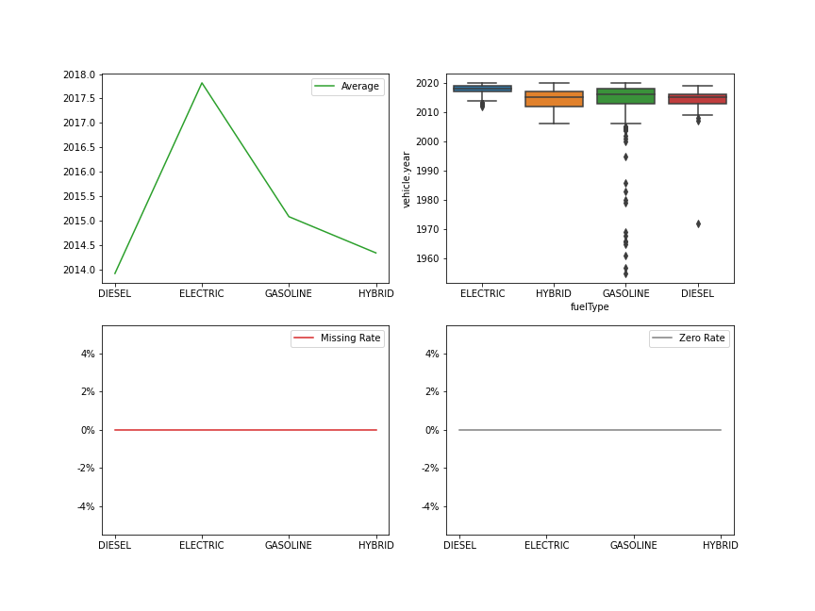
vehicle.year

